Slide 1
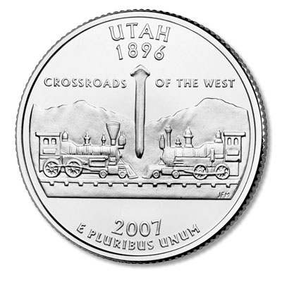
Utah The Beehive State

Slide 2
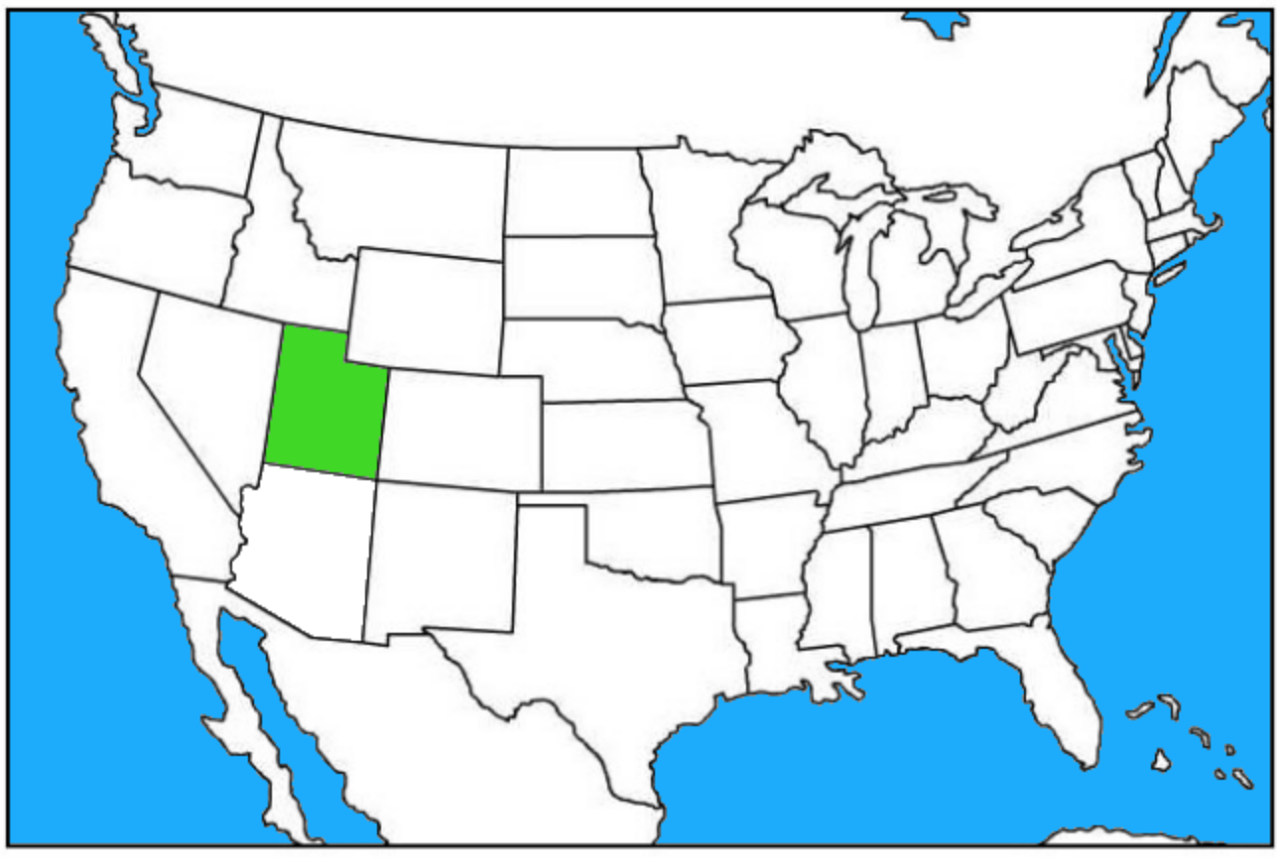
Where is Utah?
Utah is located in the western United States.
It borders six states: Idaho, Wyoming, Colorado, New Mexico, Arizona, and Nevada.
It is one of the “four corner” states.

Slide 3
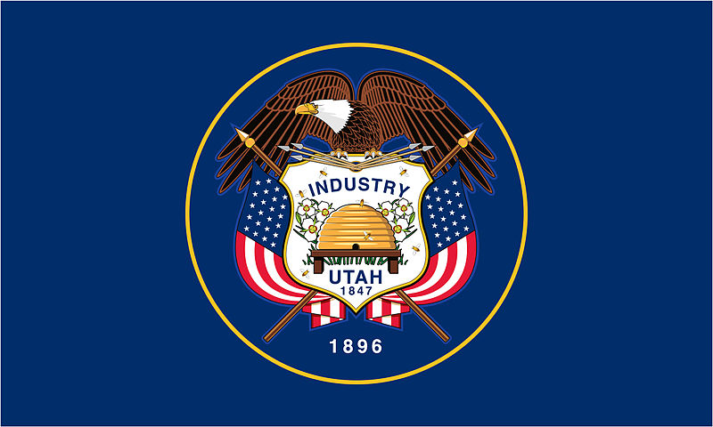
Utah Flag
The bald eagle represents protection in peace and war.
The flowers represent peace
The beehive and the word “industry” represent progress and hard work.
The flags represent Utah’s commitment to the United States.
“1896” is when Utah became a state.

Slide 4
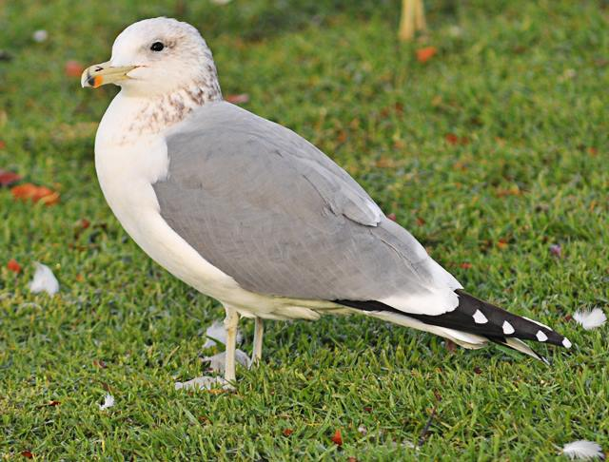
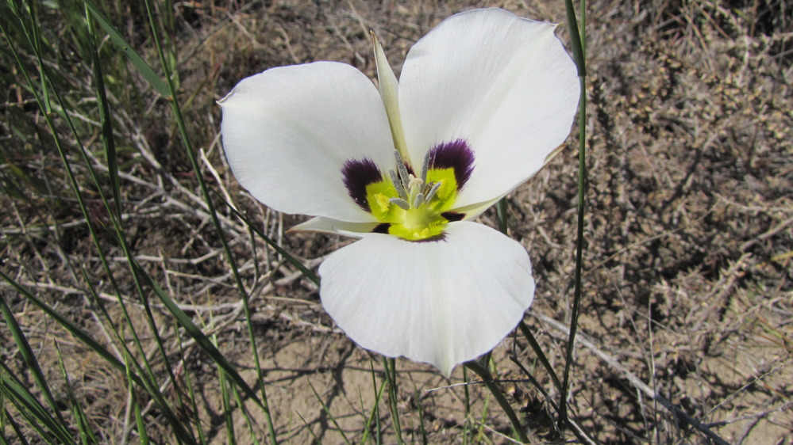
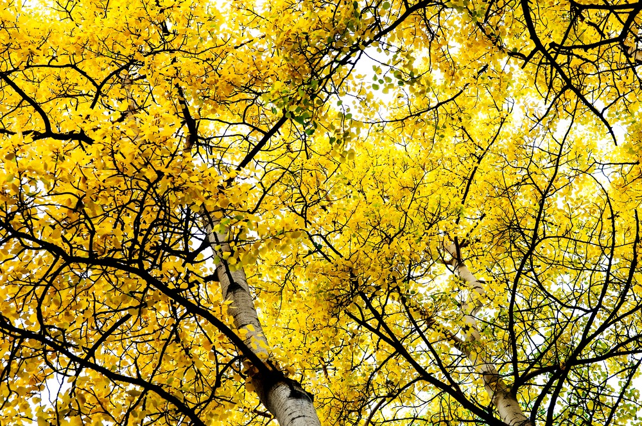
Utah Symbols
Sego Lily– state flower
California Gull – Utah’s state bird
Quaking Aspen– state tree

Slide 5
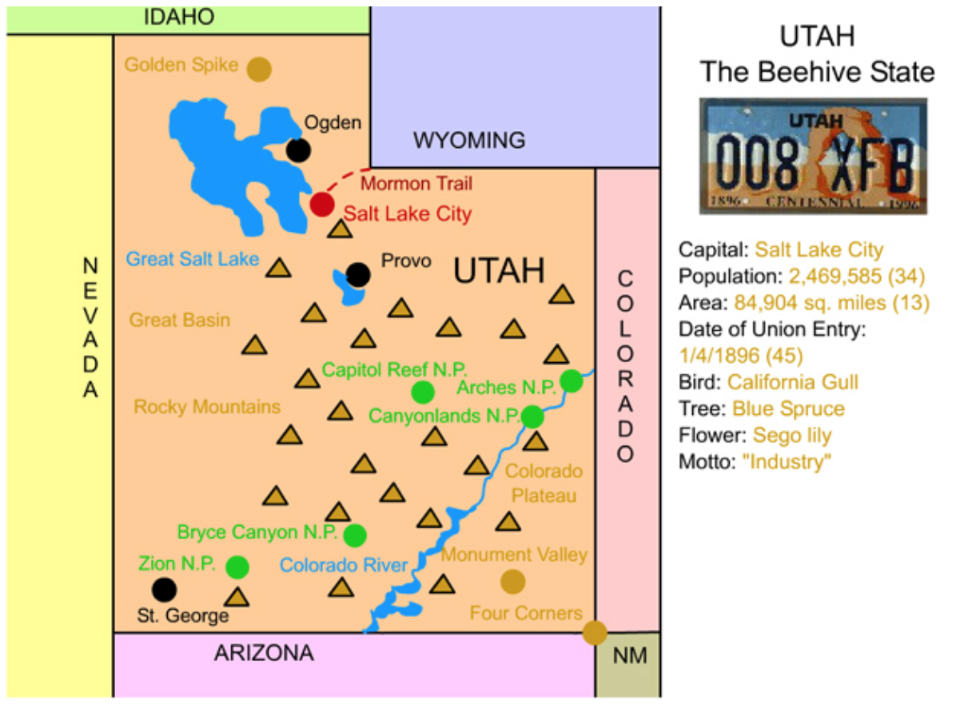
Utah Facts
Utah’s population is 3.1 million (31st in America).
With an area of nearly 85,000 square miles, Utah is America’s 13th largest state.
Utah’s highest point is Kings Peak (13,534 ft.)
Utah became a state on January 4, 1896. It was America’s 45th state.

Slide 6
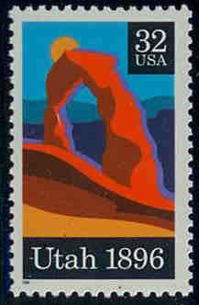
Important Dates in Utah History
1846: Ogden is founded by Miles Goodyear and marked the first permanent settlement by people of European descent in Utah.
1847: First Mormon settlers arrived in Utah under Brigham Young.
1847: Mormon settlers establish the town of Bountiful.
1858: Salt Lake City is named capital of the Utah Territory.
1869: Transcontinental Railroad linking the Union Pacific and the Central Pacific was completed at Promontory Summit.
1919: Zion National Park is created.
2002: Salt Lake City hosts the 19th Winter Olympics.

Slide 7
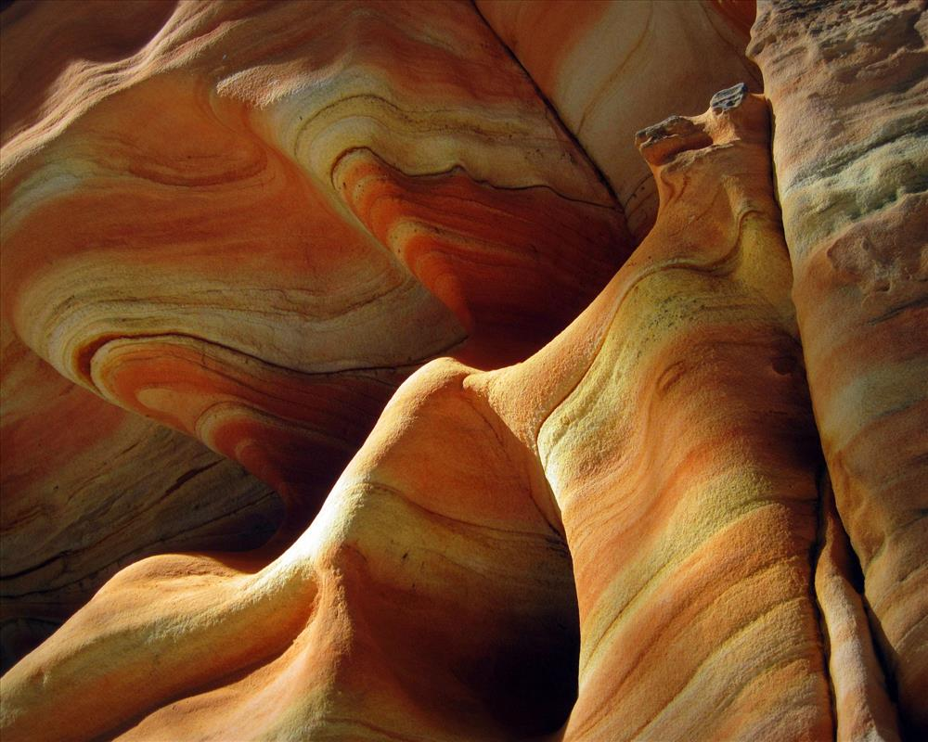
Utah’s Landforms and Waterways
Utah is located at the convergence of three major regions:
The Rocky Mountains
The Colorado Plateau
The Great Basin
Sandstone formations at Zion National Park

Slide 8
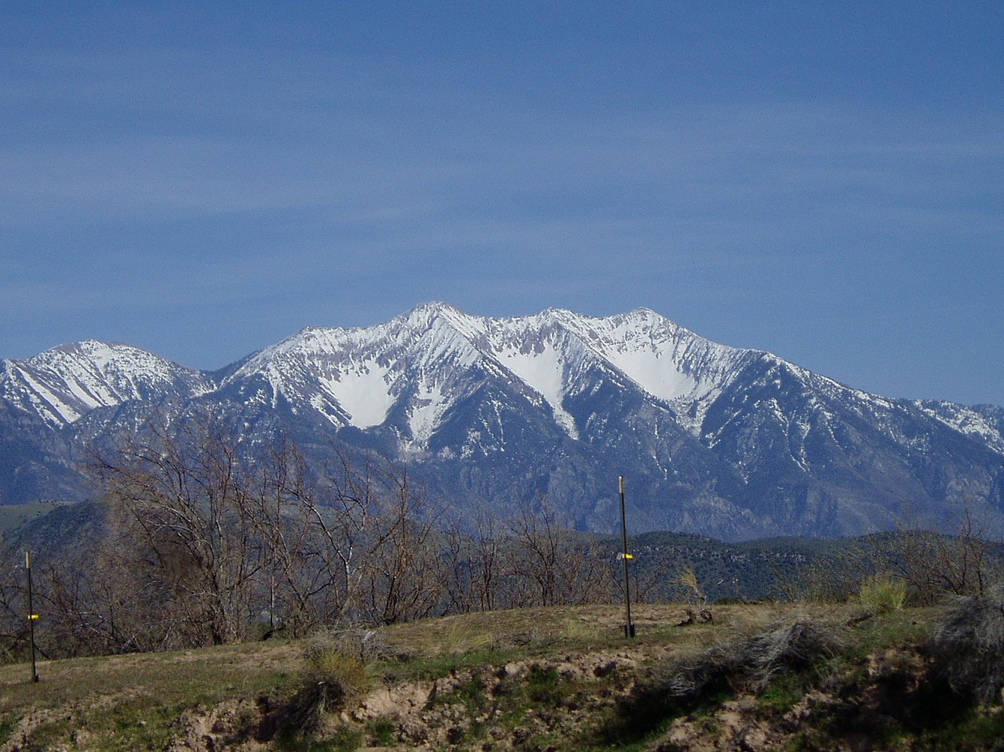
Rocky Mountains
The far northeastern portion of Utah is part of the Rocky Mountain range.
The legendary Rocky Mountains extend through much of western North America from Canada to New Mexico. The "Rockies," as they are often called, stretch over 2,000 miles.
Colorado’s Mt. Elbert is the highest point in the Rocky Mountains (14,433 ft.).
Utah’s Mt. Nebo

Slide 9
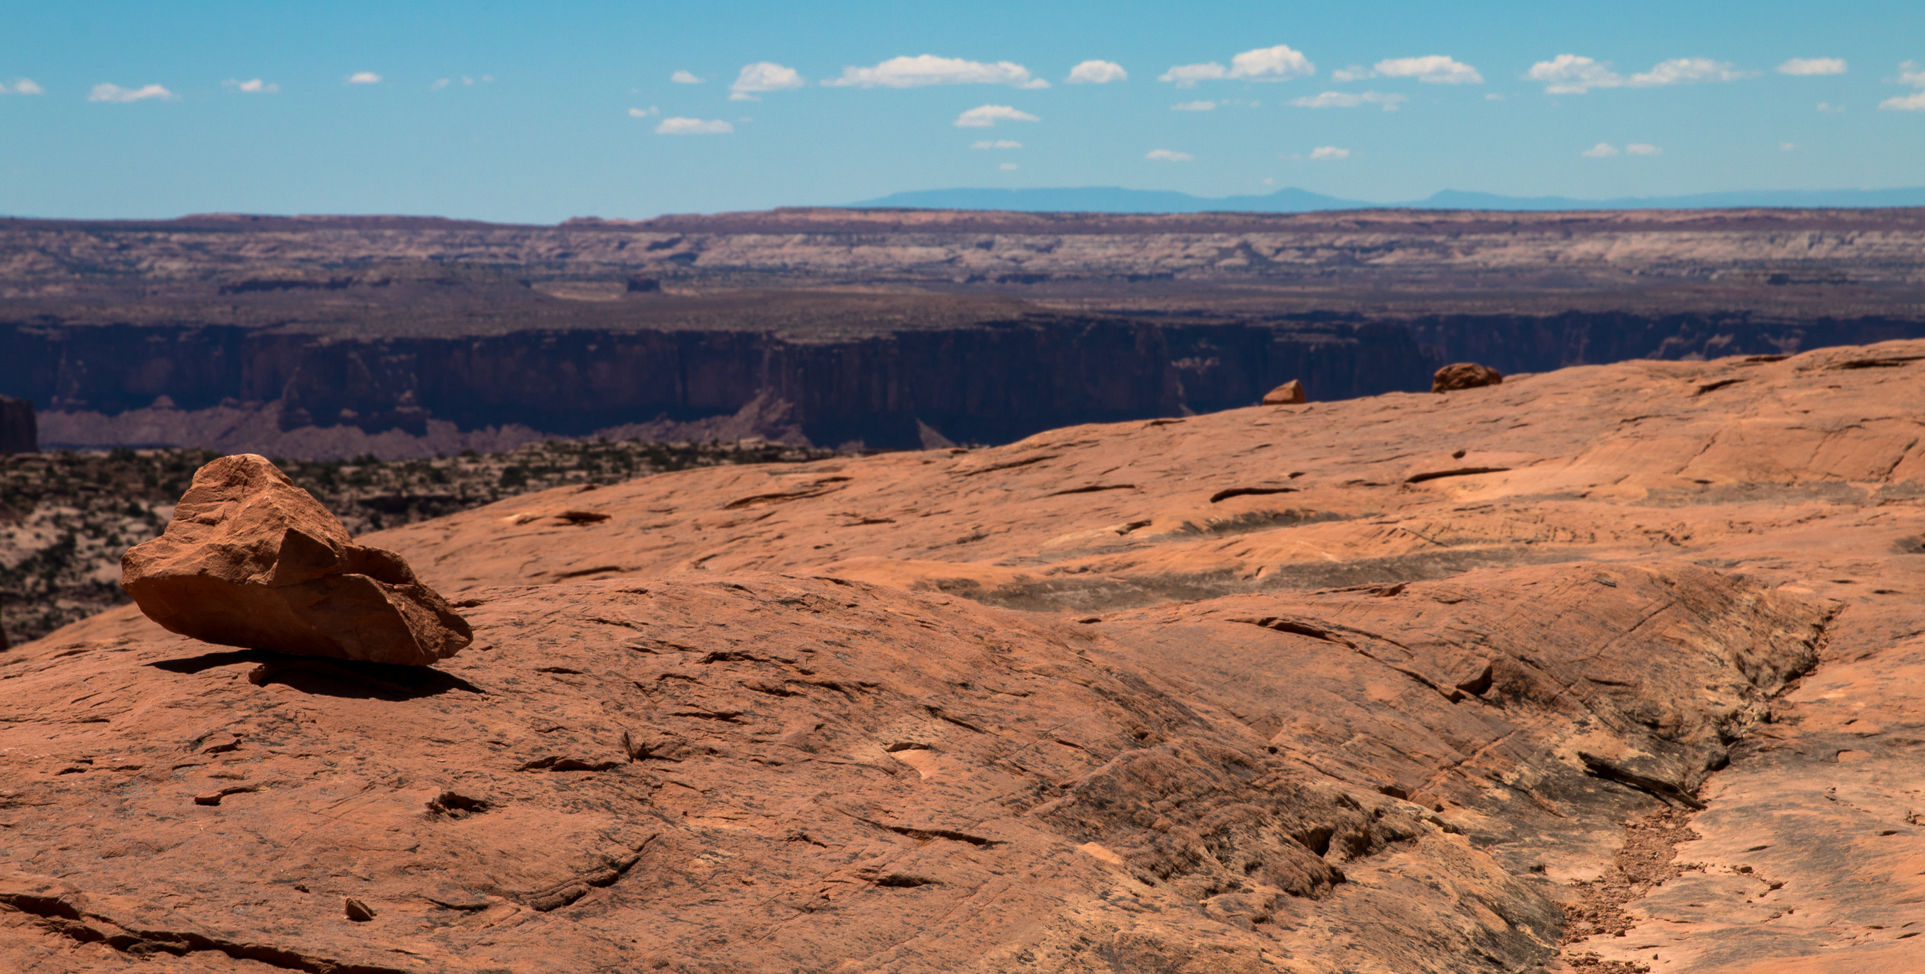
Colorado Plateau
Eastern and southern Utah are part of the Colorado Plateau – a region of deserts, scattered forests, and incredible rock formations centered in the four corners region of Arizona, Colorado, Utah, and New Mexico.
Colorado Plateau

Slide 10
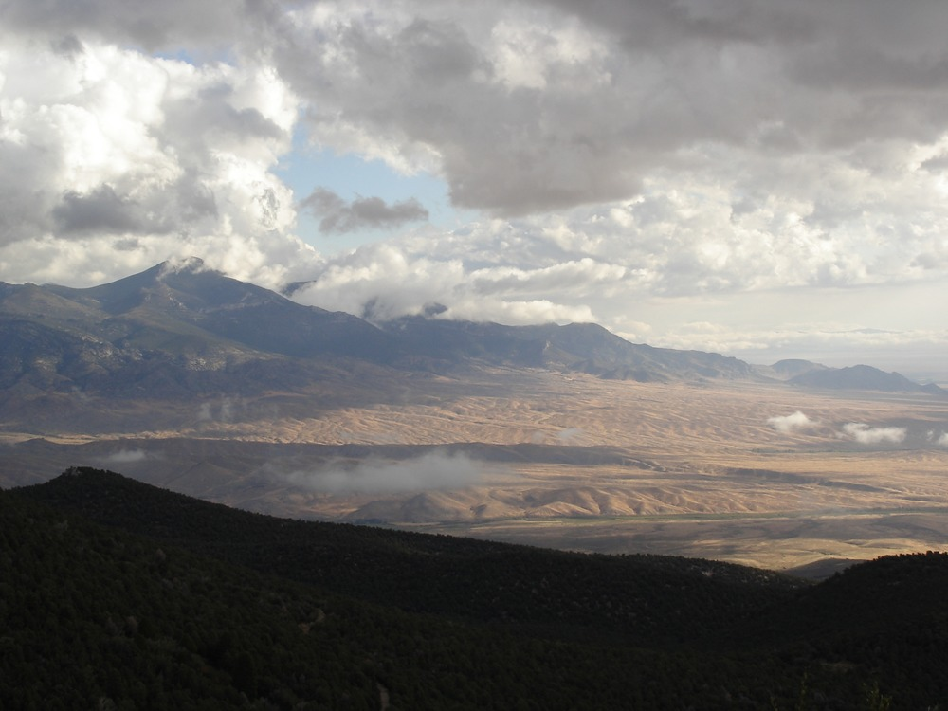
Great Basin
Encompassing the entire state of Nevada, and much of Utah, Idaho, and Oregon, the Great Basin is an arid, mountainous area in the western United States, between the Rocky Mountains and the Sierra Nevada Range.
It consists of a series of mountain ranges in Nevada including the East Humboldt, Ruby, and White Mountains. The basin itself is a series of watersheds with no outlet to the sea or to a river that flows to the sea. Any precipitation that falls evaporates, seeps into the ground, or forms playas, short lived lakes that eventually evaporate.
Great Basin

Slide 11
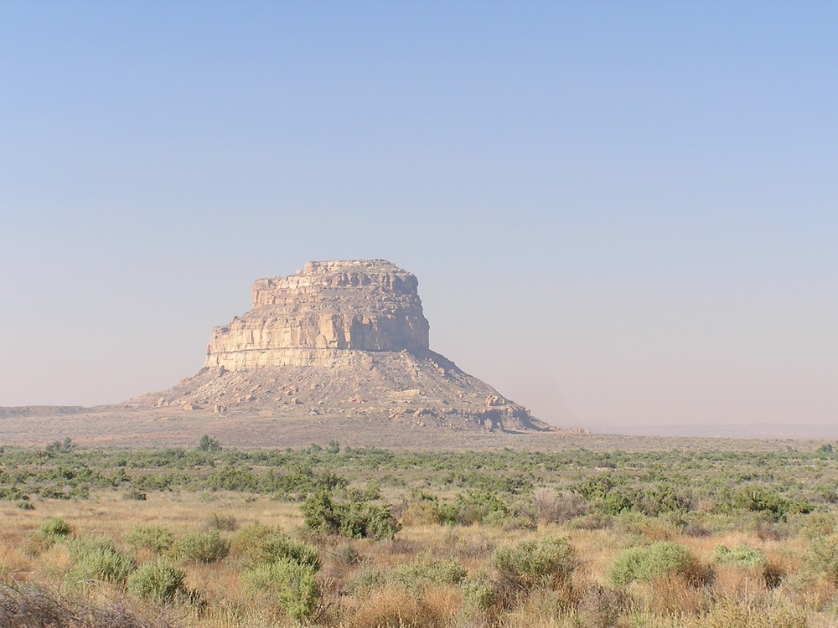
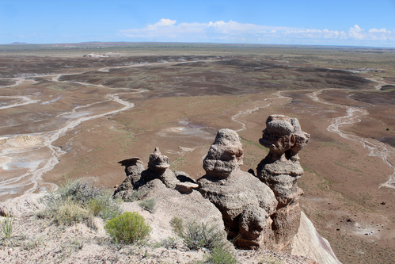
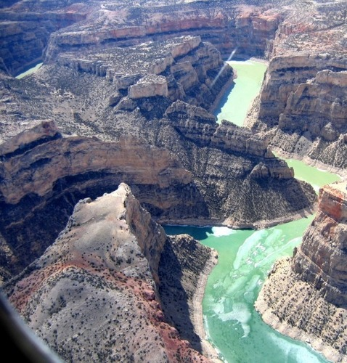
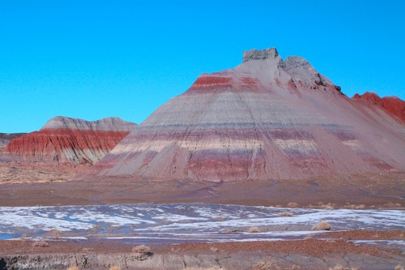
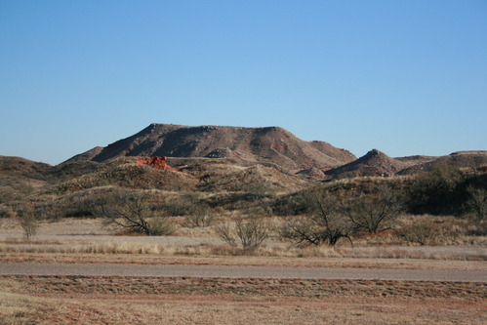
Common Utah Landforms
Butte
Hoodoos
Canyon
Badlands
Mesa

Slide 12
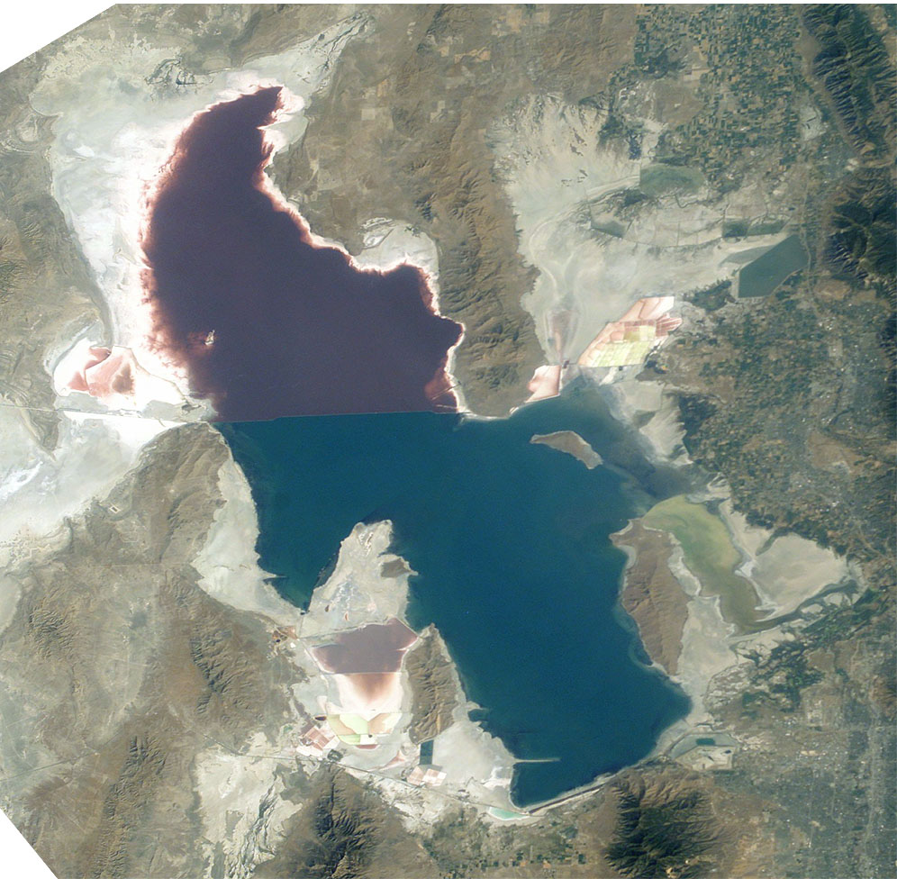
Utah Landforms and Waterways
The Great Salt Lake, located entirely in Utah, is the largest salt lake in the Western Hemisphere. The lake is very shallow (on average 16 feet deep), and thus, its land area fluctuates. On average, it covers an area of about 1,700 square miles.
At 1,450 feet in length, the Colorado River is the longest river that flows through Utah. It flows through several of Utah’s national parks.
Satellite image of the Great Salt Lake

Slide 13
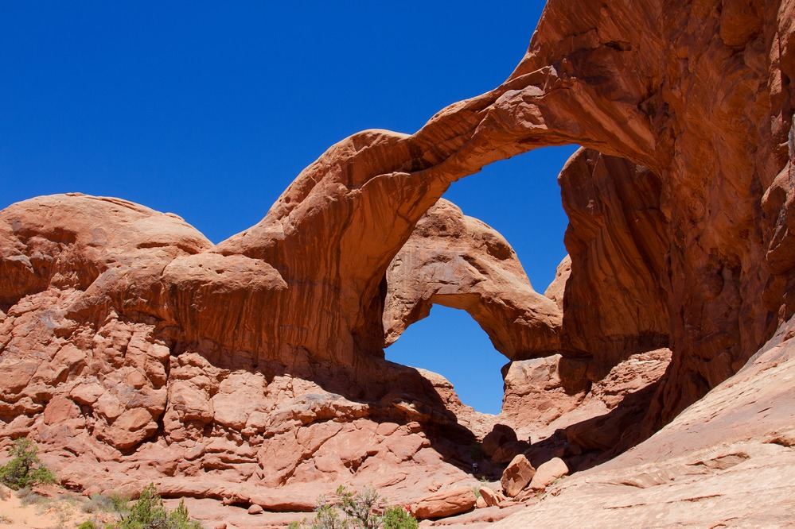
Utah ’s National Parks – Arches
Located in southeastern Utah.
Arches National Park, located in eastern Utah, features more than 2,000 natural sandstone arches, including Delicate Arch, which is featured on the Utah license plate. The Olympic torch even passed through Delicate Arch in 2002.
The famous arches were formed from a sandstone layer deposited by an ancient sea. Over time, the salt underneath the sandstone forced it to rise and crack. The rising sandstone was exposed to wind, precipitation and erosion, which resulted in the formation of the arches.
Arches National Park

Slide 14
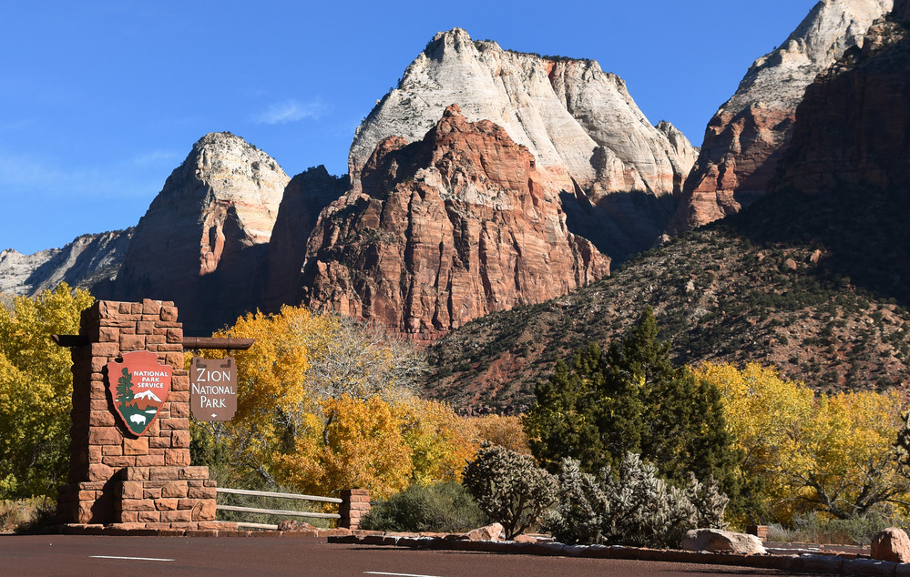
Utah ’s National Parks – Zion
Located in southwestern Utah.
Zion National Park, located in southwestern Utah, features a dramatic landscape of towering cliffs and beautiful canyons. Zion is situated on the junction of three major geographical zones: the Colorado Plateau, Great Basin, and Mojave Desert. The park’s unusual geography supports a high level of biodiversity.
The name "Zion" is an ancient Hebrew word that translates to "sanctuary". Zion is by far, the most visited national park in Utah.
Zion National Park

Slide 15
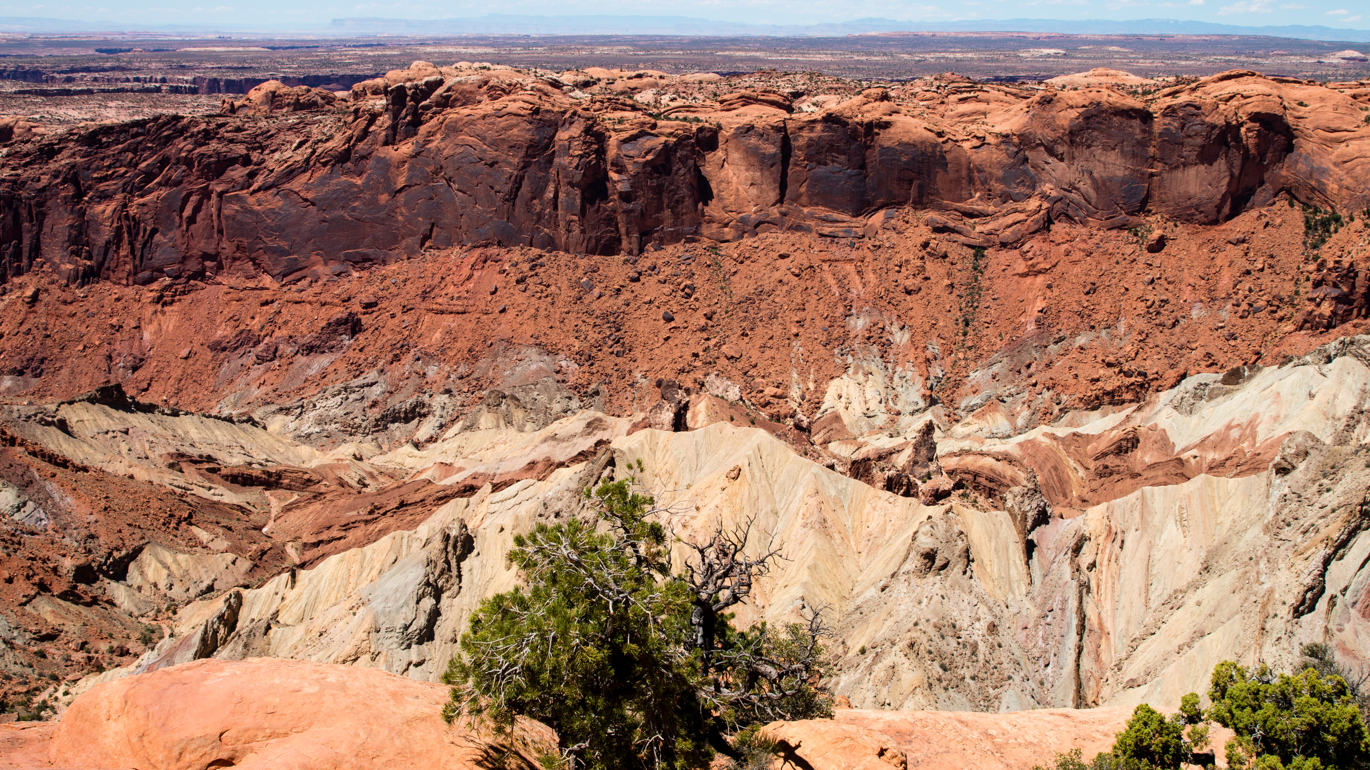
Utah’s National Parks – Canyonlands
Located in southeastern Utah.
Canyonlands National Park, located in southern Utah, is one of five spectacular national parks in Utah. It features stunning and colorful landscapes of sandstone eroded into hundreds of buttes, canyons, and mesas by the Colorado and Green Rivers. Canyons carved by these rivers have resulted in the division of the park into three sections, the Island in the Sky, the Needles, and the Maze.
Canyonlands also features petroglyphs and stone and mud dwellings from the ancient Puebloan people.
Canyonlands National Park

Slide 16
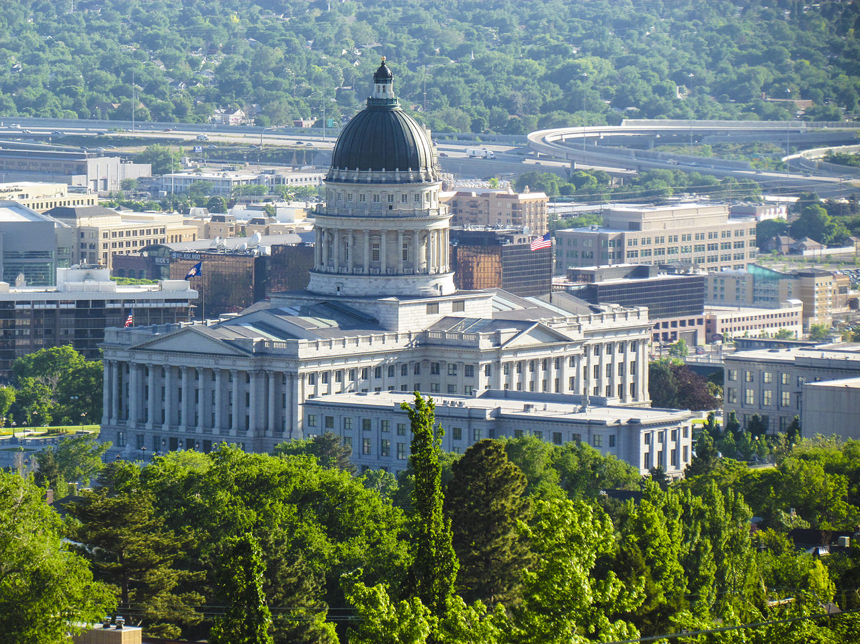
Utah’s Capital – Salt Lake City
Salt Lake City was founded by Brigham Young and members of the Church of Jesus Christ of Latter Day Saints (Mormons) in 1847. The Mormons were looking for an isolated place to practice their religious beliefs without being persecuted. Immediately, the settlers began building their temple, which was completed 40 years later. The settlers organized a new state, which they called Deseret. Congress denied their petition for statehood and instead created the Utah Territory. Salt Lake City was named capital of the territory in 1858.
Utah Capital

Slide 17
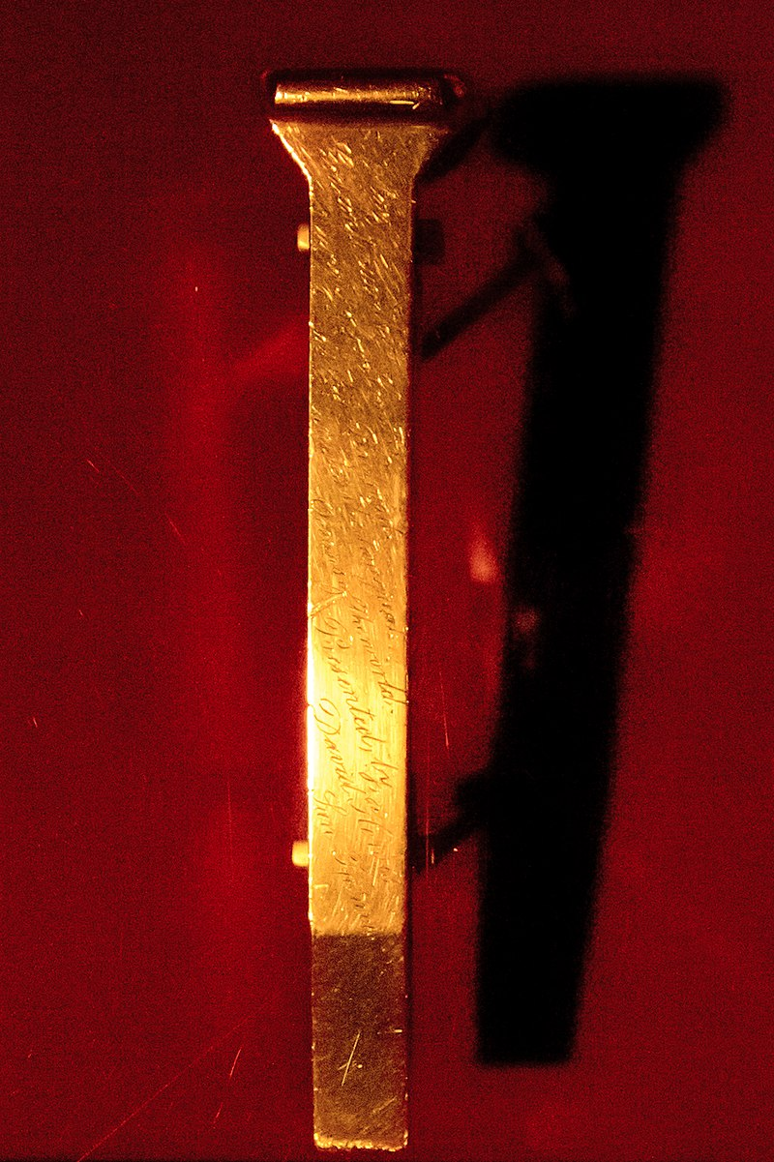
Utah’s Important Landmarks – Golden Spike Nat. Historic Site
The Golden Spike was a ceremonial golden railway spike hammered into the ground by Leland Stanford on May 10, 1869 in Promontory Summit, Utah.
The Golden Spike marked the completion of the world’s first Transcontinental Railroad, as the Central Pacific and Union Pacific Railroads met. The completion of the Trans-continental Railroad allowed people to travel from coast to coast in about seven days. Before the railroad, the same trip would have taken months.

Slide 18
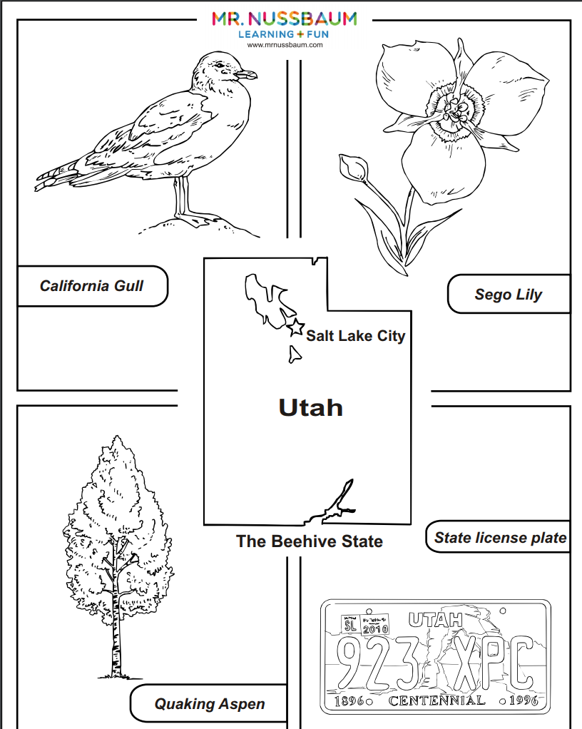
Follow-up Activities
MrN 365 has dozens of Utah-themed activities.
Search for Utah, or, visit the geography section and click on “Utah.”

