Slide 1
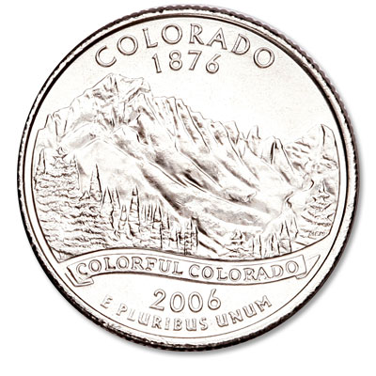
Colorado The Centennial State

Slide 2
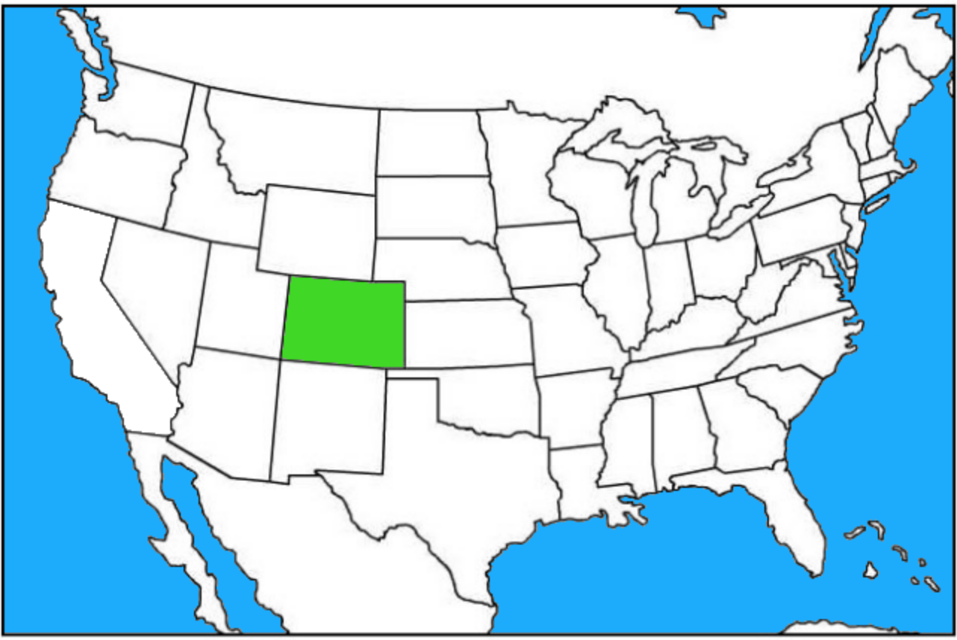
Where is Colorado?
Colorado is located in the western United States.
It borders seven states: Nebraska, Kansas, Oklahoma, New Mexico, Arizona, Utah, and Wyoming.
It is one of the “four corner” states.

Slide 3
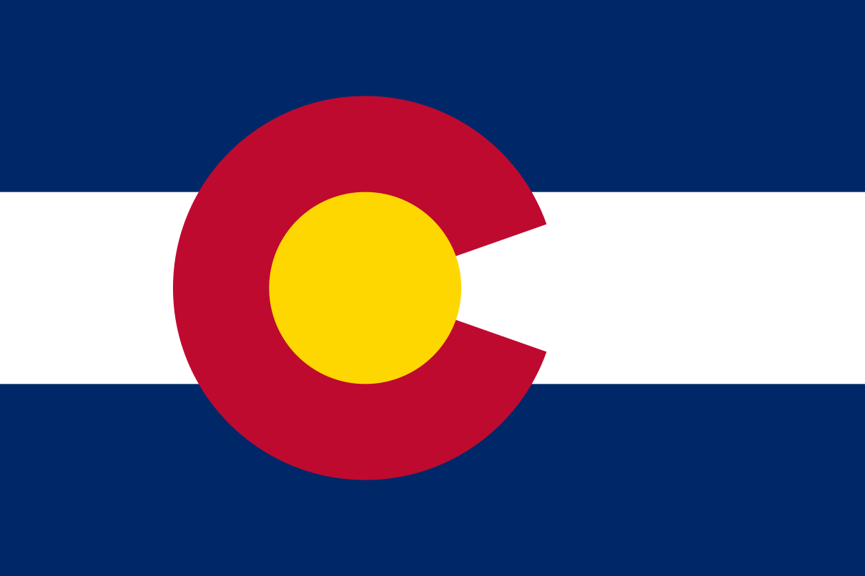
Colorado Flag
The blue in the flag symbolizes Colorado’s blue skies
The red represents its red soil
The white in the flag represents Colorado’s snowy mountains.
The gold circle represents Colorado’s “abundant” sunshine.

Slide 4
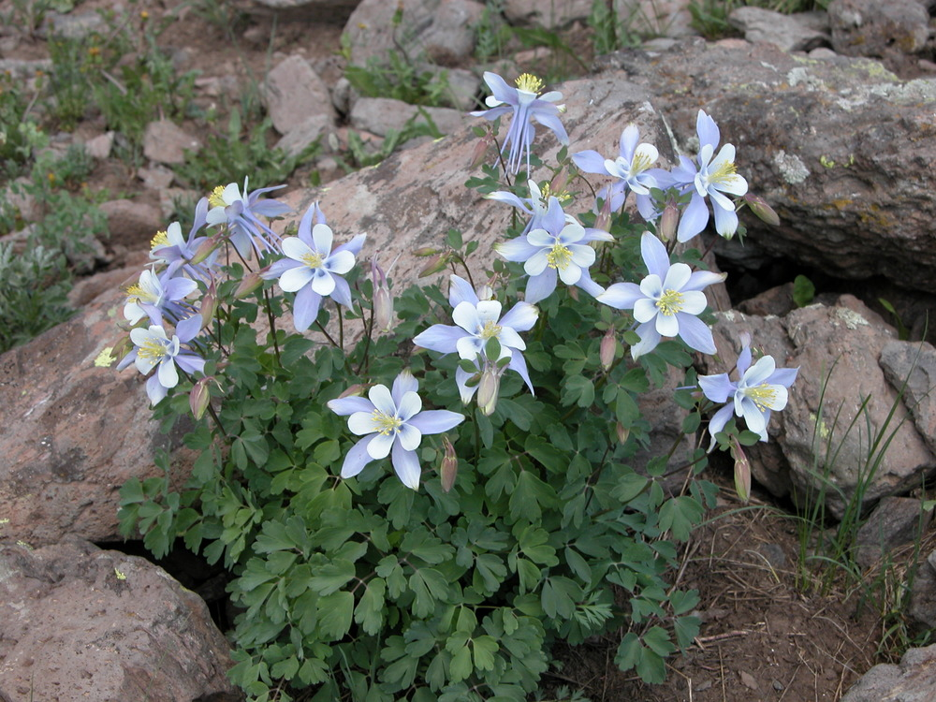
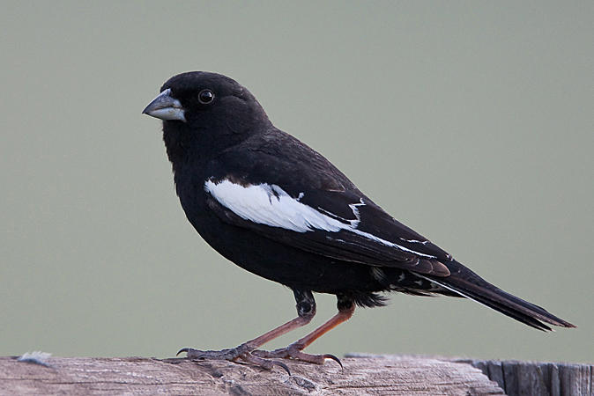
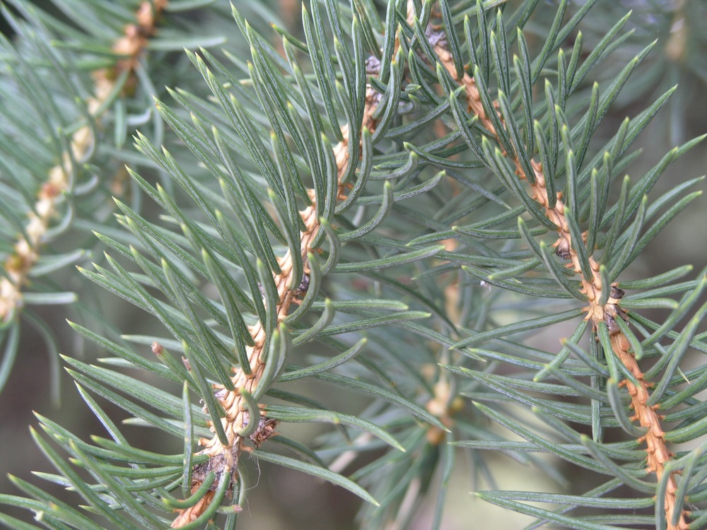
Colorado Symbols
Rocky Mountain Columbine– state flower
Lark Bunting – Colorado state bird
Colorado Blue Spruce– state tree

Slide 5
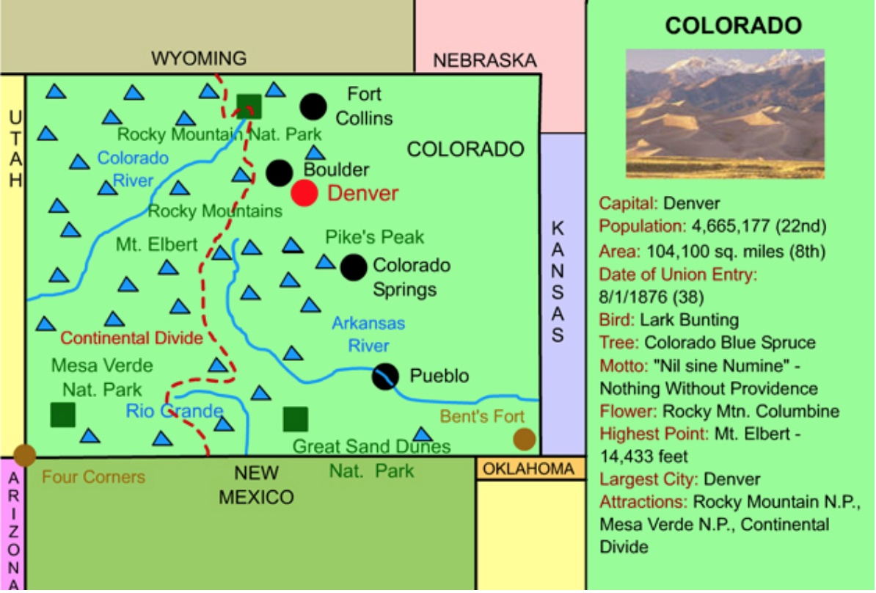
Colorado Facts
Colorado’s population is 5.7 million (21st in America).
With an area exceeding 104,000 square miles, Colorado is America’s eighth largest state.
Colorado’s highest point is Mt. Elbert (14,433 ft.)
Colorado became a state on August 1, 1876. It was America’s 38th state.

Slide 6
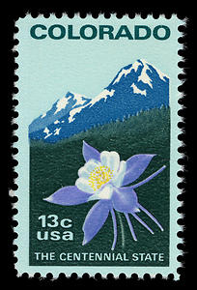
Important Dates in Colorado History
1540: Spanish explorer Francisco Coronado explores Colorado searching for the Seven Cities of Cibola.
1803: The United States purchased what is now most of eastern Colorado from France. Napoleon Bonaparte acquired this land from Spain in 1800 and sold it to the United States in 1803 as a part of the Louisiana Purchase, which was signed by President Thomas Jefferson.
1859: A large number of settlers came to Colorado, creating areas such as Boulder and Denver, during The Colorado Gold Rush of 1859. This is considered the largest gold rush in American history.
1876: Colorado became the 38th state. It is called the Centennial State because it was admitted to the Union one hundred years after the signing of the Declaration of Independence.
1958: The United States Air Force Academy was built close to Colorado Springs.

Slide 7
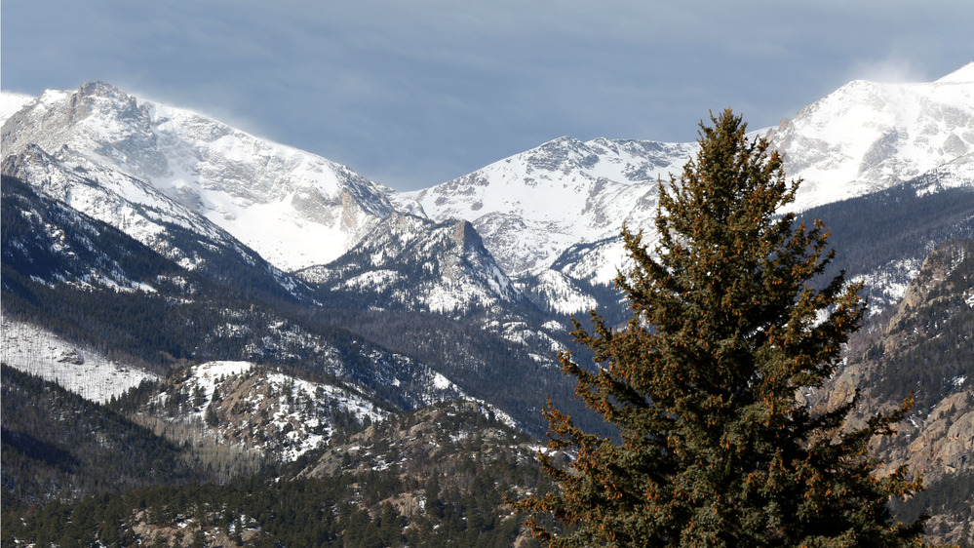
Colorado’s Landforms and Waterways
The central and western portions of Colorado are dominated by the Rocky Mountains.
The legendary Rocky Mountains extend through much of western North America from Canada to New Mexico. The "Rockies," as they are often called, stretch over 2,000 miles.
Colorado’s Mt. Elbert is the highest point in the Rocky Mountains (14,433 ft.). Colorado has 53 peaks above 14,000 feet tall.
Colorado’s Rocky Mountains

Slide 8
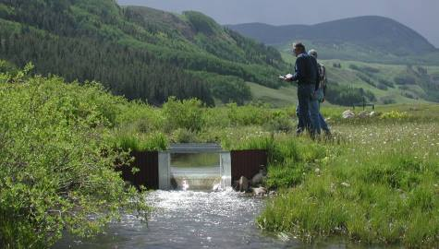
Colorado’s Landforms and Waterways
The sources of three major rivers: the Colorado and Arkansas, and the Rio Grande are in Colorado.
At 1,450 feet in length, the Colorado River starts as what seems like a small creek in Rocky Mountain National Park. As it winds southwest, it flows through Utah, forms the Grand Canyon in Arizona, and forms the border of California and Arizona before flowing out through the Gulf of California.
Source of the Colorado River in
Rocky Mountain National Park

Slide 9
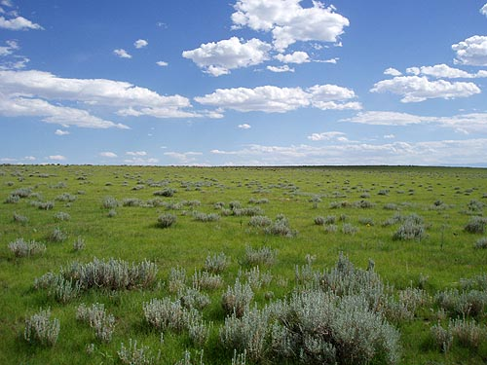
Colorado’s Landforms and Waterways
Eastern Colorado is part of the Great Plains. Near Denver, the plains abruptly give way to the Rocky Mountains.
Southwestern Colorado is part of the Colorado Plateau – a region of deserts, scattered forests, and incredible rock formations centered in the four corners region of Arizona, Colorado, Utah, and New Mexico.
Colorado Plains

Slide 10
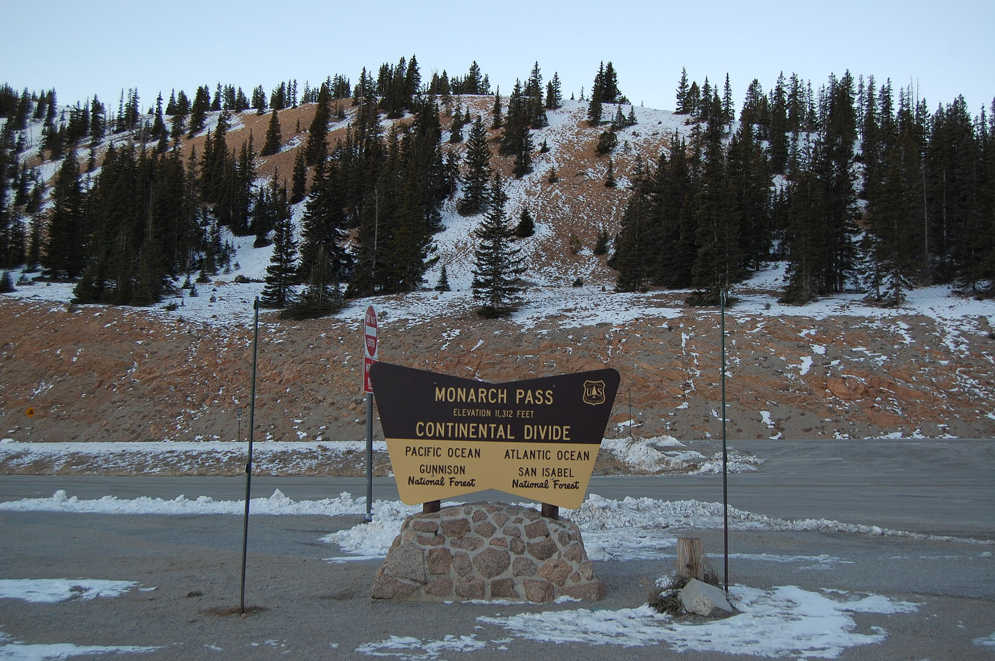
Continental Divide
The Continental Divide extends through the state of Colorado.
The Continental Divide is a “line” that forms the border between the watersheds of the Atlantic Ocean and the Pacific Ocean. In other words, waterways that occur west of the divide flow out (eventually) to the Pacific Ocean, and waterways that fall east of the line flow out (eventually) to the Atlantic Ocean. Therefore, rain or snow that falls west of the divide can be expected to end up in the Pacific Ocean and rain or snow that falls east of the divide can be expected to end up in the Atlantic Ocean.
Continental Divide

Slide 11
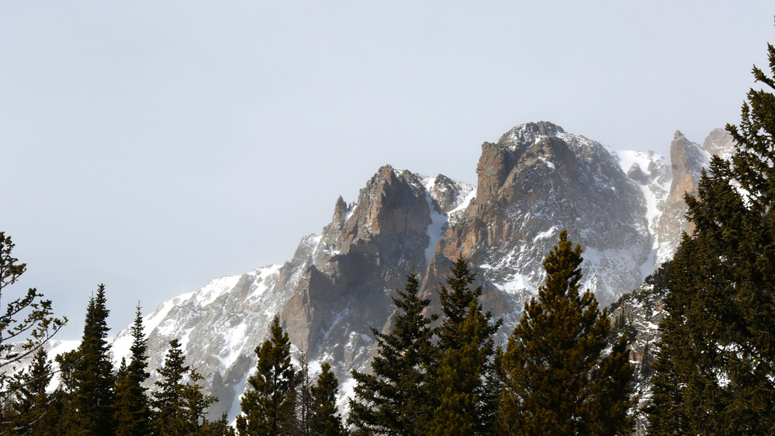
Colorado ’s National Parks – Rocky Mountain
Located in north central Colorado.
Positioned on the Continental Divide, at the headwaters of the mighty Colorado River, Rocky Mountain National Park is a spectacular celebration of the Rocky Mountains. The park features dazzling views of the towering peaks and is full of wildlife including black bears, moose, mountain lions, and elk.
Trail Ridge Road, in the heart of the park, ascends to over 12,000 feet above sea level. It is the highest paved road in the United States.
Rocky Mountain National Park

Slide 12
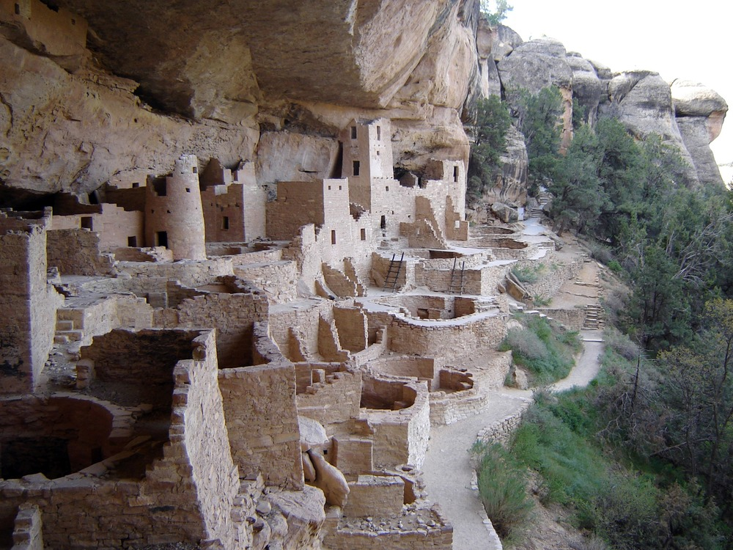
Colorado ’s National Parks – Mesa Verde
Located in southwestern Colorado.
Mesa Verde National Park features unparalleled views into pre-colonization America. From 600 to 1300 AD, the park was home to ancient Puebloan people who built cliff dwellings (houses built into shallow caves in the canyon walls).
One of the dwellings, known as Cliff Palace, is the largest cliff dwelling in North America. It contains over 150 rooms, which indicated 100 to 120 people lived in it.
Cliff Palace in Mesa Verde National Park

Slide 13
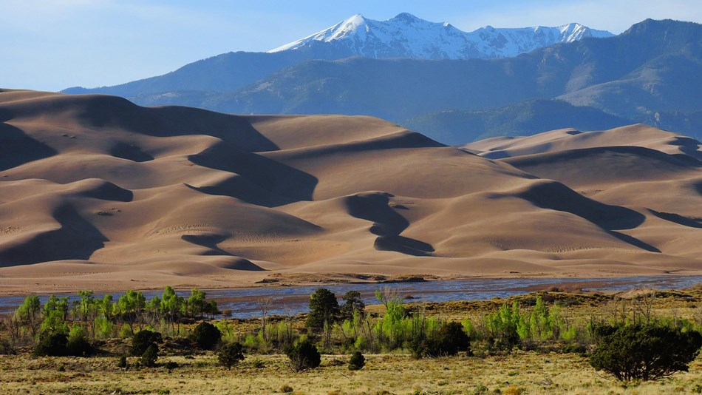
Colorado’s National Parks – Great Sand Dunes
Located in southern Colorado.
Great Sand Dunes National Park and Preserve, located in southern Colorado, is one of our newest national parks. The park features the nation’s highest sand dunes – towering 750 feet against the Sangre de Cristo Mountains. The dunes are spectacular, and even contain creeks that flow on top of the sand.
Great Sand Dunes National Park and Preserve also features a variety of wildlife, and several insect species found nowhere else on earth.
Great Sand Dunes National Park

Slide 14
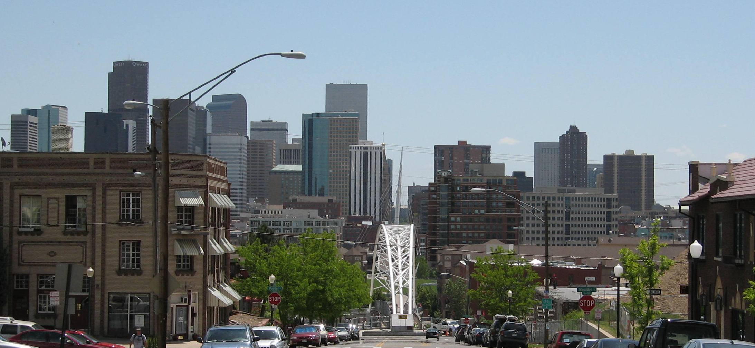
Colorado’s Capital – Denver
Located at the junction of the Great Plains and Rocky Mountains, Denver is the largest city in Colorado. Originally called Montana City, Denver was named after Kansas Territory governor James W. Denver.
The city was incorporated in 1861 and became capital of the Colorado Territory in 1865. Today, Denver is a thriving city. It is home to many major corporations such as Coors, Quizno’s, and Frontier Airlines. It is called "The Mile High City" because its altitude is 5,280 feet above sea level.
Denver

Slide 15
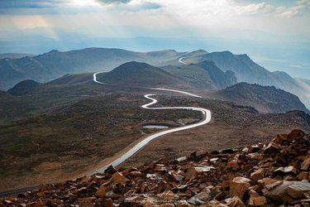
Colorado’s Important Landmarks – Pikes Peak
Pikes Peak (14,110 ft.) is the most visited mountain in North America, and the second most visited in the world. The peak itself is the easternmost high peak in the Rockies. It came to symbolize the gold rush of 1859. It was named after Zebulon Pike, who surveyed the area after the Louisiana Purchase (1806).
Highway that ascends Pikes Peak

Slide 16
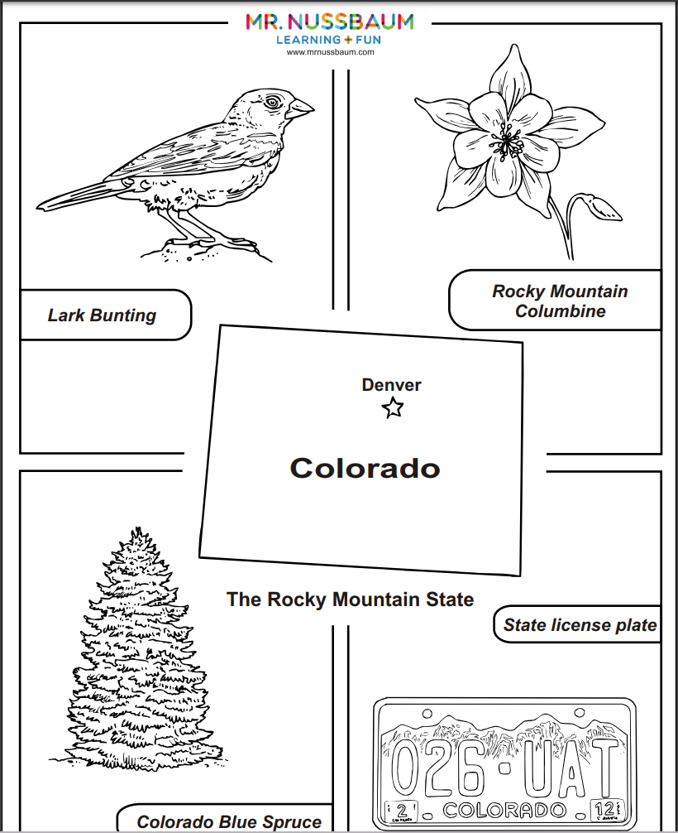
Follow-up Activities
MrN 365 has dozens of Colorado-themed activities.
Search for Colorado, or, visit the geography section and click on “Colorado.”

