Slide 1
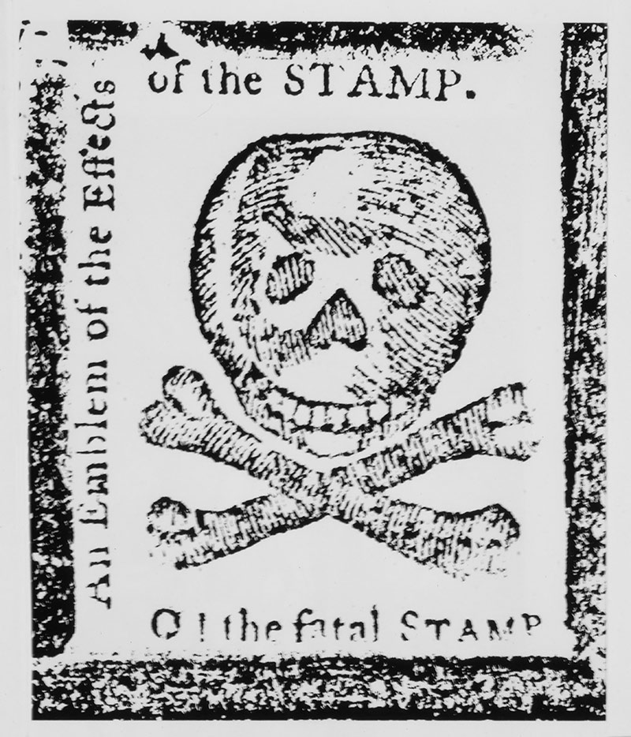

The American Revolution Series
Causes:
The Continental Congresses

Slide 2
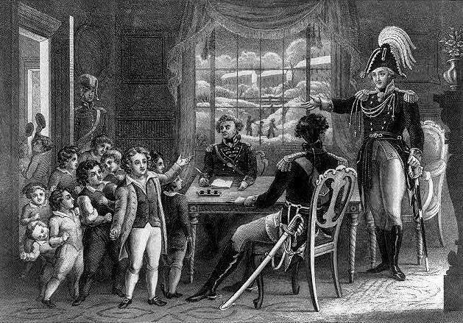
1774
Following the issuance of the Intolerable Acts, it was clear that Parliament was “flexing its muscles” on the Americans.

Slide 3
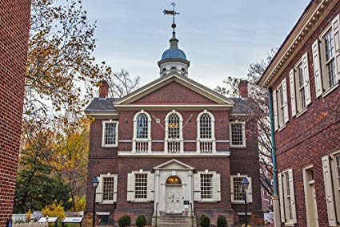
1774
It was time for the Americans to act. On September 5, 1774, delegates from 12 of the 13 colonies met at Carpenter’s Hall in Philadelphia. The meeting would last until late October.

Slide 4
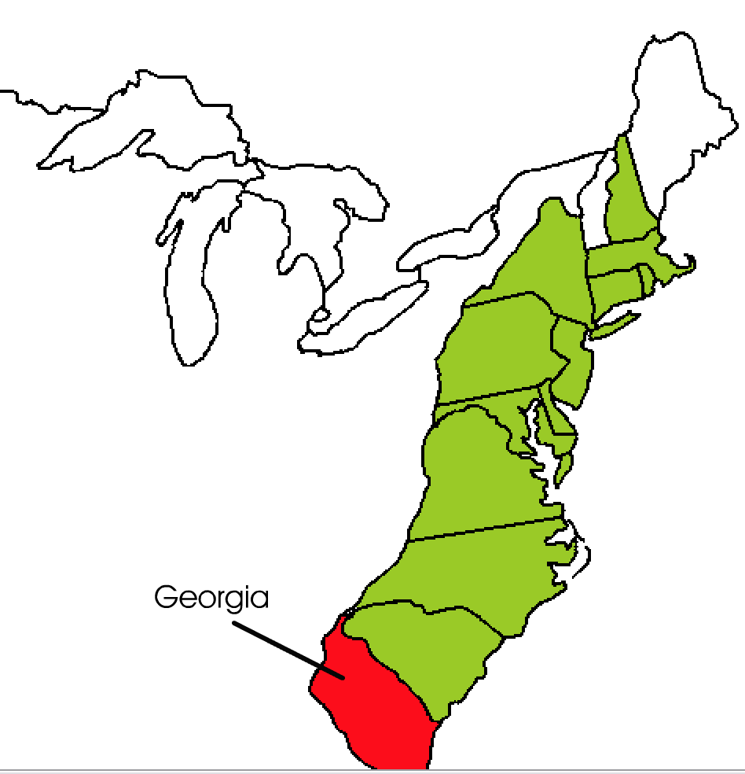
Why only 12?
- Georgia refused to send a delegate.
- Georgia was the newest colony and was at war with the Creek Indians. It needed help from the British military and decided against taking actions that might threaten aid.

Slide 5
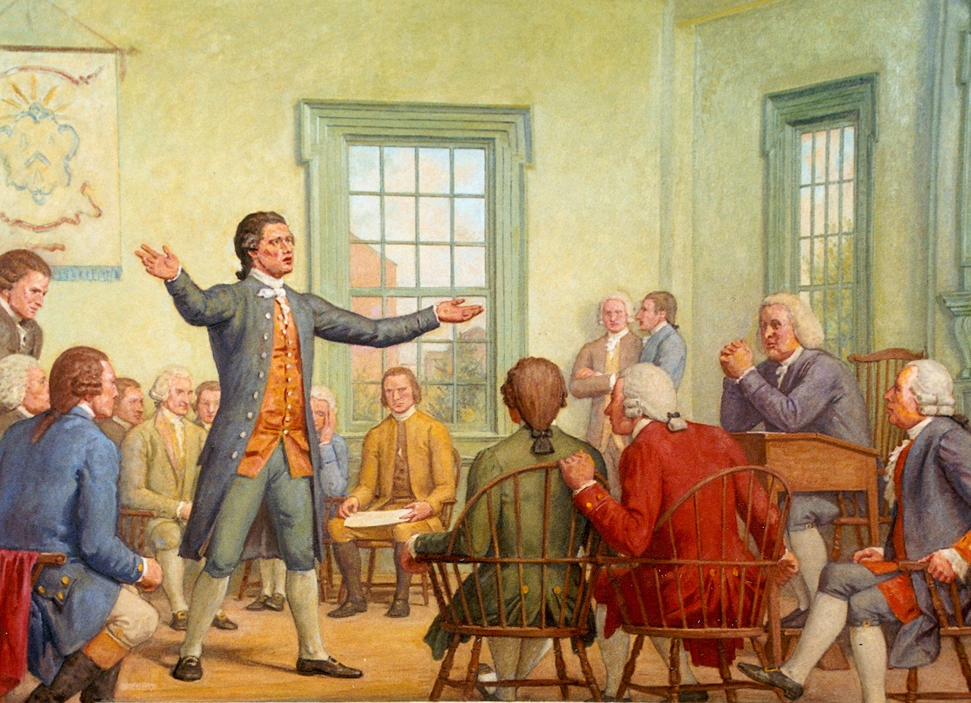
Why did they meet?
To discuss a united response to the Intolerable Acts. This was significant because the colonies were acting (more or less) together, as a single entity rather than as separate colonies.

Slide 6
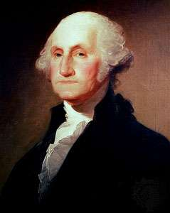
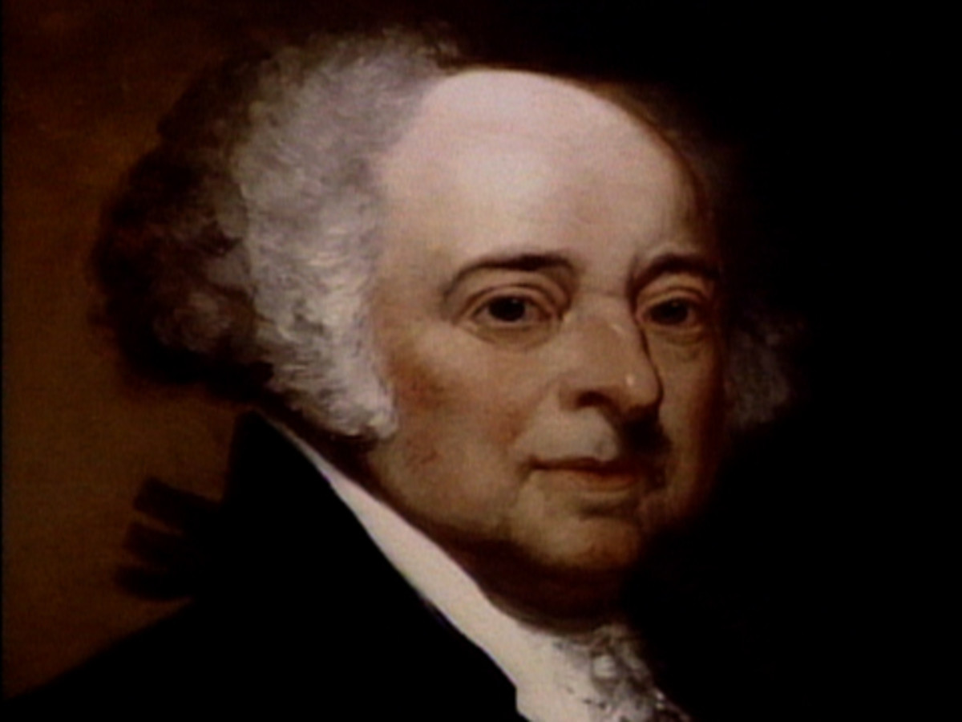
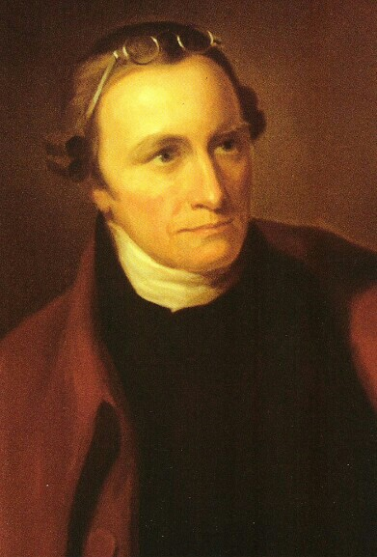
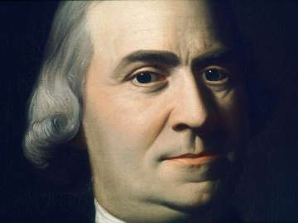
Who was part of the Continental Congress?
Samuel Adams
George Washington
John Adams
Patrick Henry

Slide 7
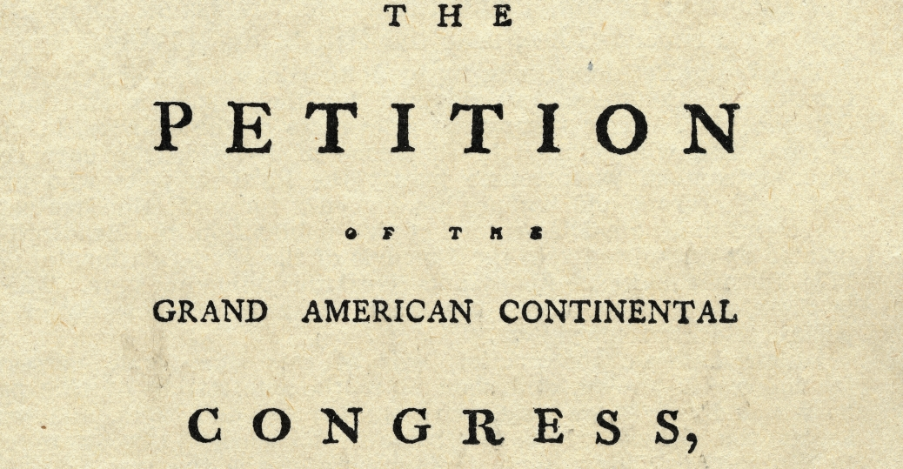
What did they decide?
To draft a Declaration of Rights, which acknowledged allegiance to England but declared that Parliament did not have the right to tax Americans.
Boycott British imports.
To meet again in 1775 if Parliament failed to respond to the colonists.
Some called for the people of Massachusetts to stockpile arms in the event the British royal governor attempted to rule by force.

Slide 8
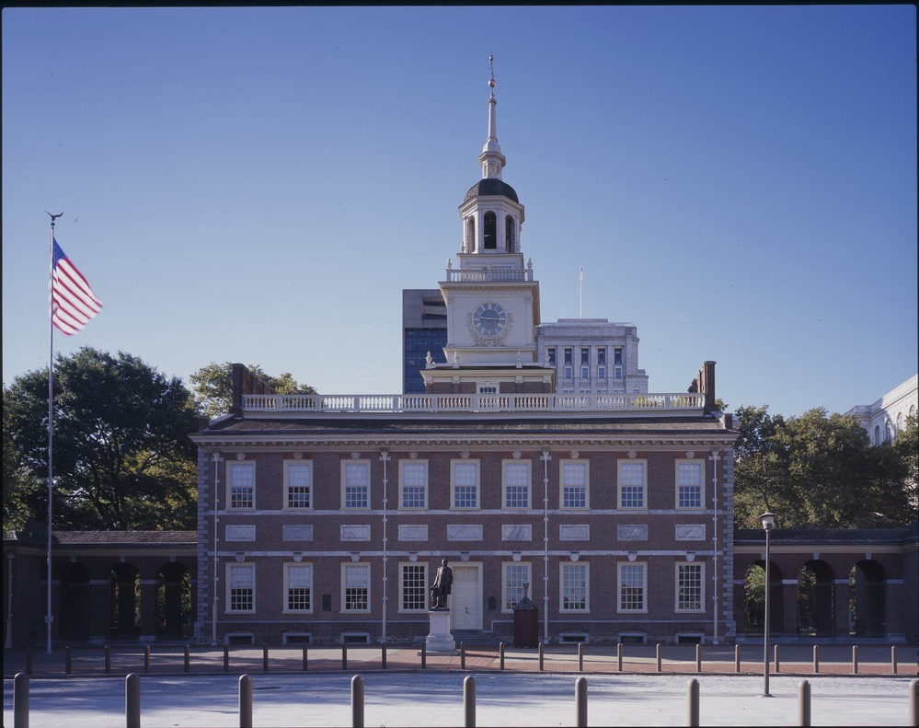
Second Continental Congress
On May 10, 1775, the Second
Continental Congress met at Independence Hall in Philadelphia.
Circumstances had changed
since the first meeting!

Slide 9
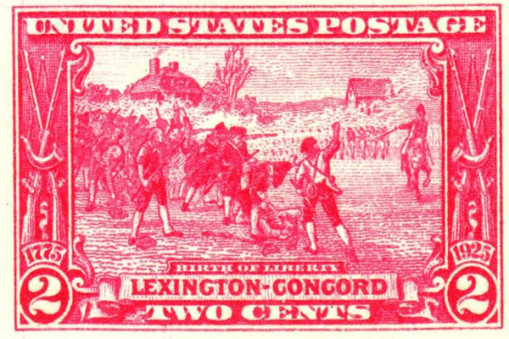
Second Continental Congress
Parliament had ignored America’s petition
A deadly battle had taken place at Lexington and Concord, Massachusetts in April.
Both British “Redcoats” and American “Minutemen” had been killed in the battle.

Slide 10
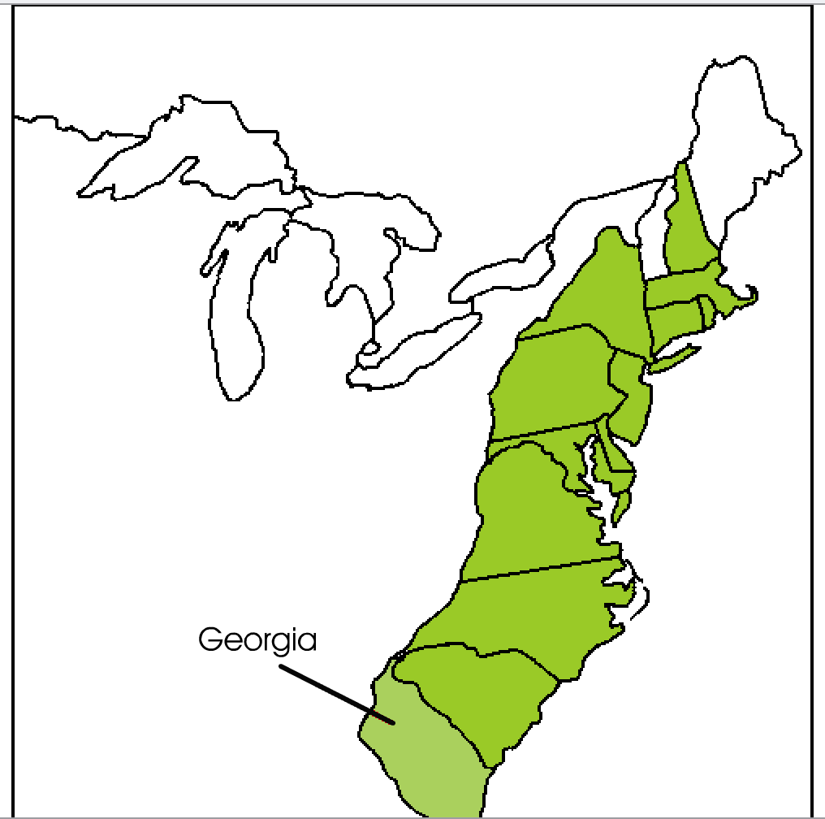
Second Continental Congress
This time all 13 colonies sent delegates, including Georgia (though not at first!)

Slide 11
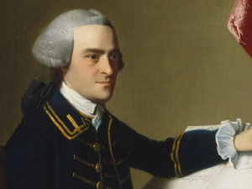
What happened at the Second Continental Congress?
Congress took on the role of the war-time government.
It named John Hancock, of Massachusetts, president of the Congress.

Slide 12
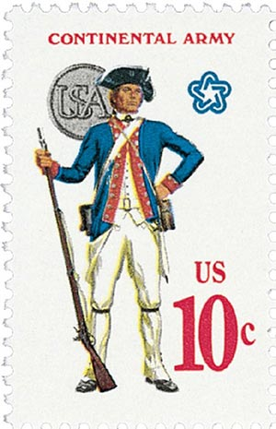
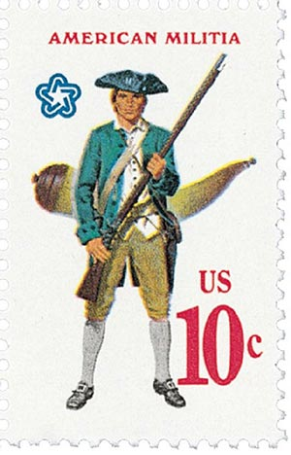
What happened at the Second Continental Congress?
It authorized the creation of the Continental Army to fight the British.
It named George Washington Commander-in-Chief.

Slide 13
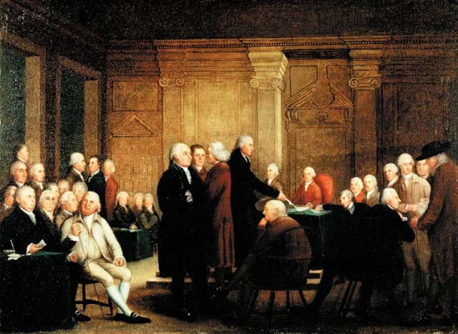
What happened at the Second Continental Congress?
It authorized the creation of paper money
It would be in charge of signing treaties and appointing ambassadors

Slide 14
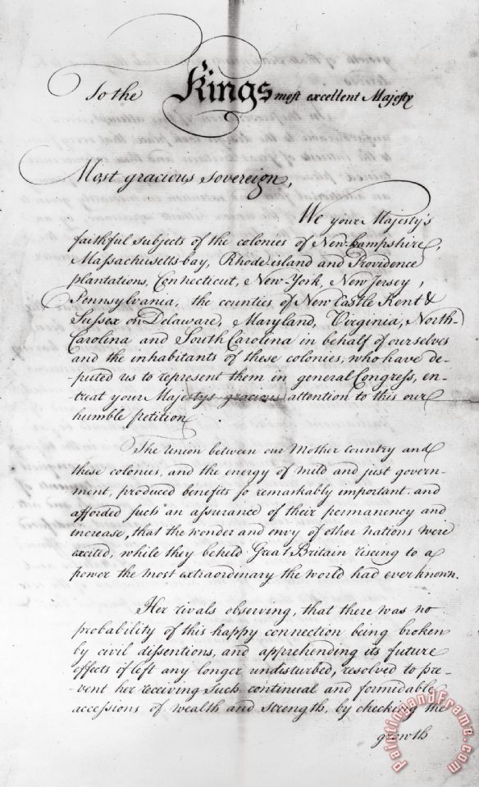
What was the British Response?
It rejected the Olive Branch Petition, a last effort to appeal to Parliament for peace.
It hired 30,000 “Hessian” soldiers from Germany to help in the coming war.

Slide 15
Follow-up Activity
The First and Second Continental were important events in the Revolutionary Era. Based on the information you’ve learned, compare and contrast them. You should list three similarities and three differences.
https://www.mrn365.com/activity/2934

